Slide 1

Digital Logic Design

Slide 2
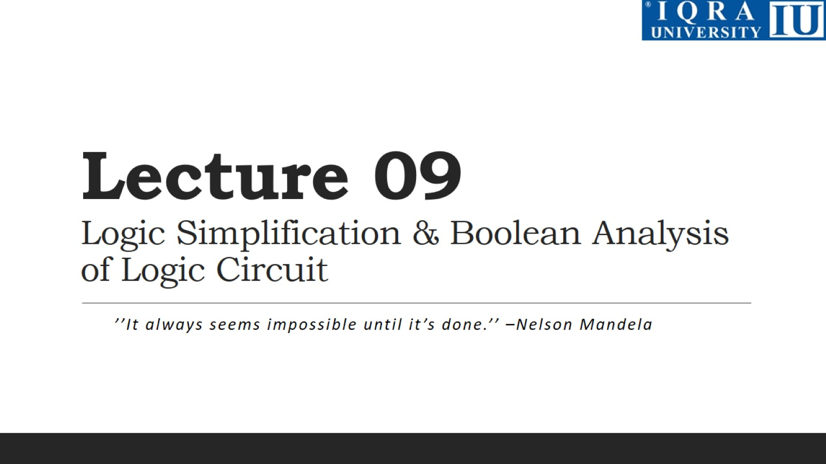
Lecture 09 Logic Simplification & Boolean Analysis of Logic Circuit

Slide 3
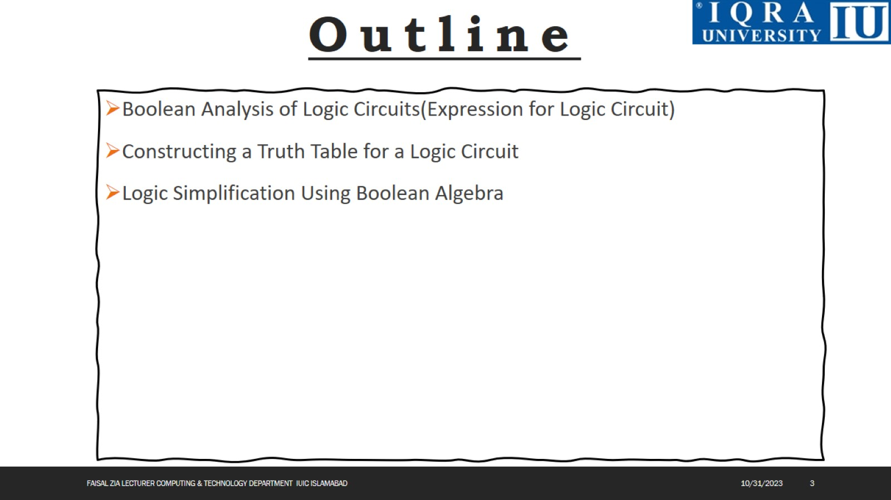

Slide 4
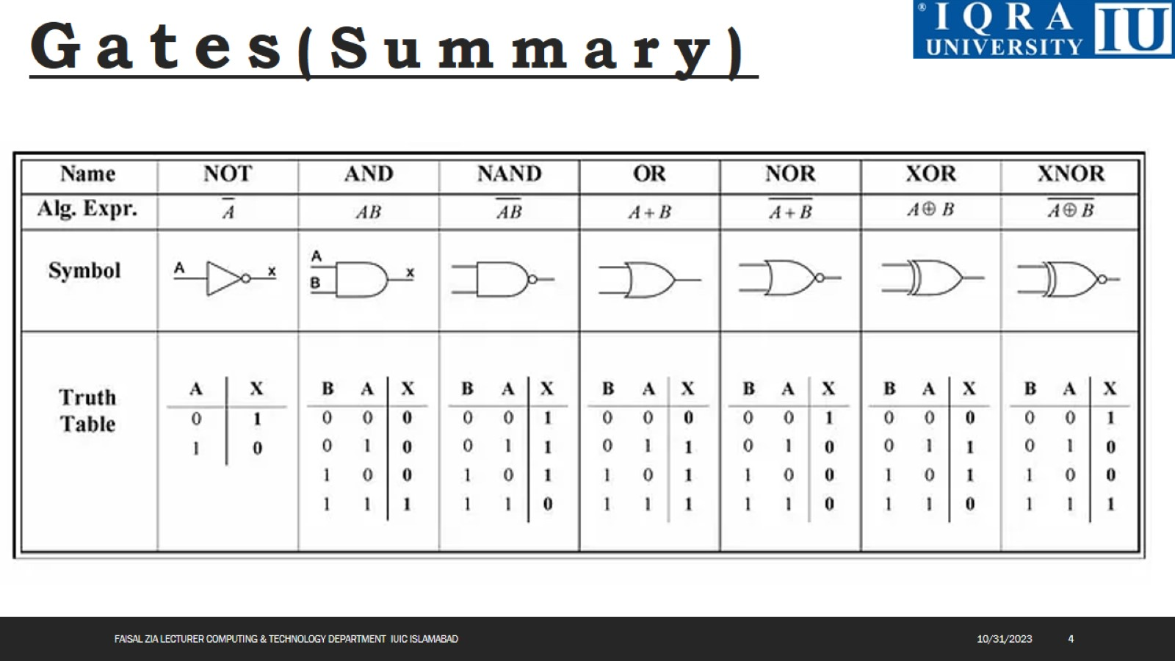

Slide 5
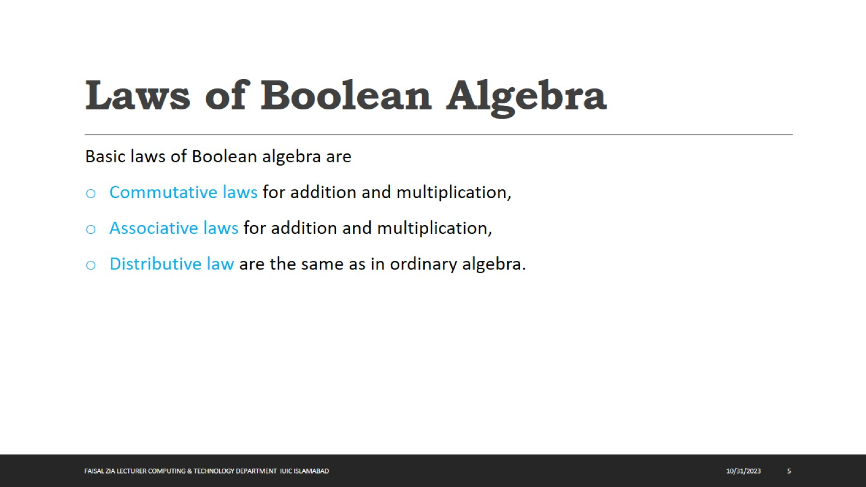
Laws of Boolean Algebra

Slide 6
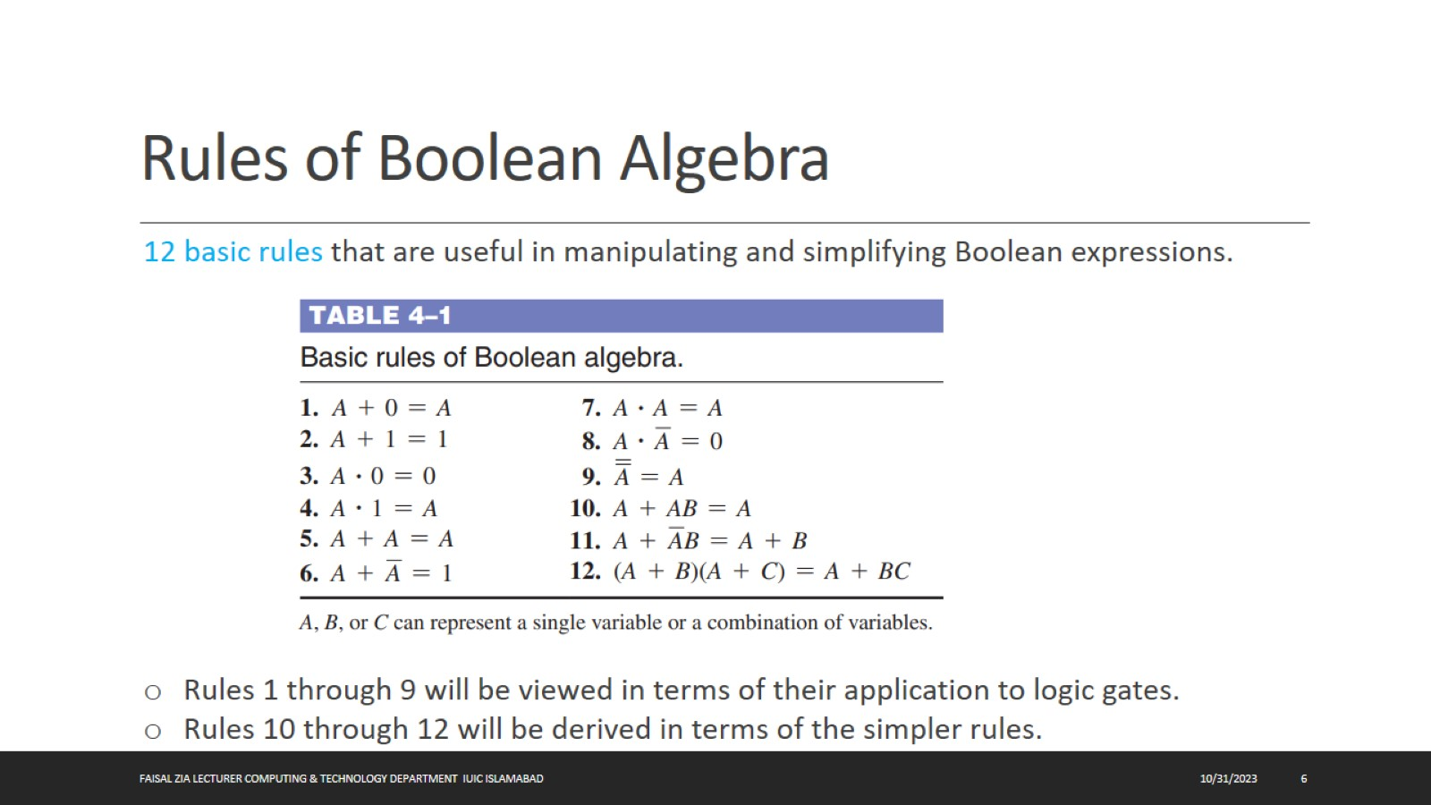
Rules of Boolean Algebra

Slide 7
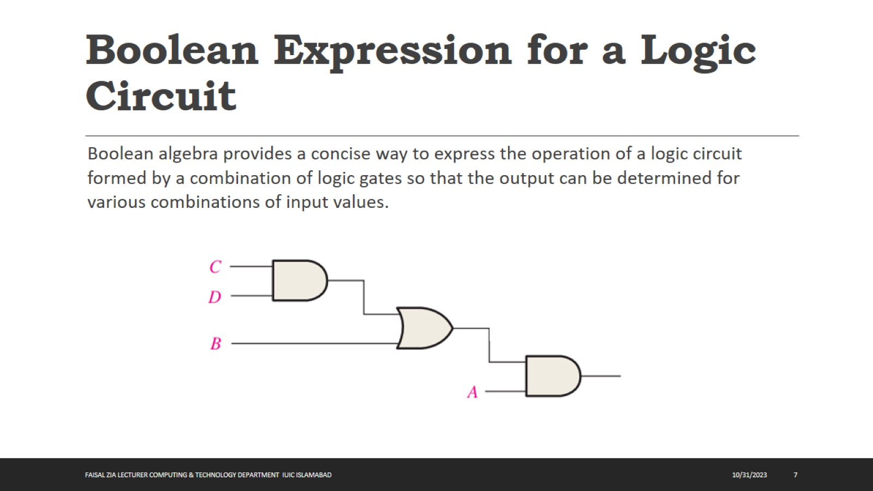
Boolean Expression for a Logic Circuit

Slide 8
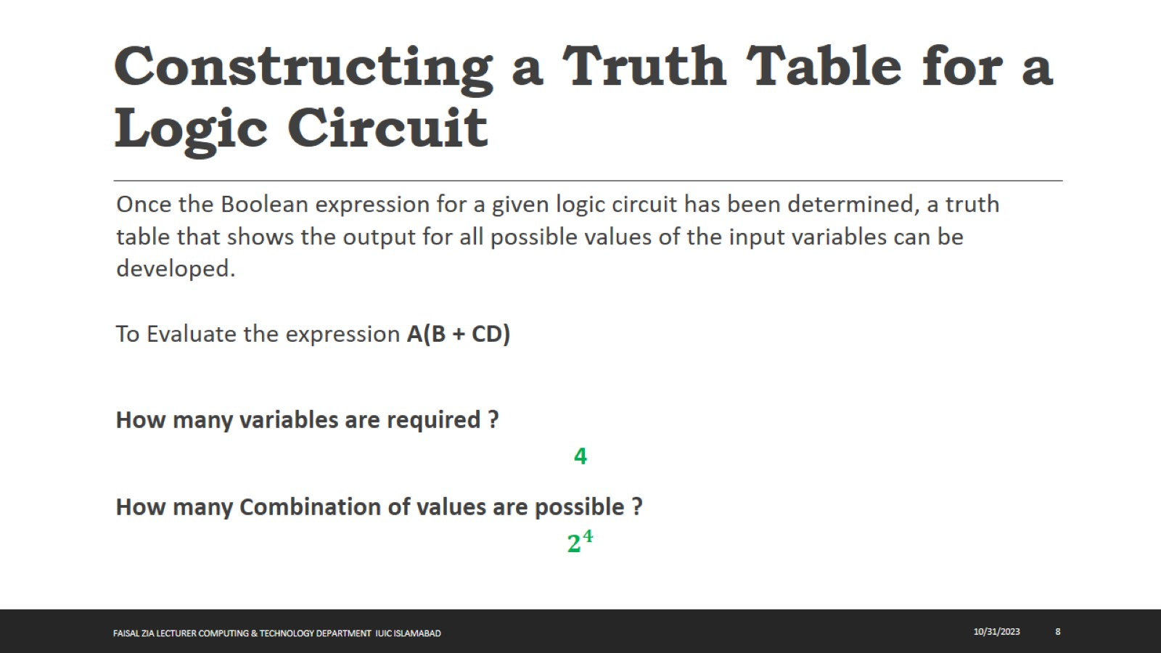
Constructing a Truth Table for a Logic Circuit

Slide 9
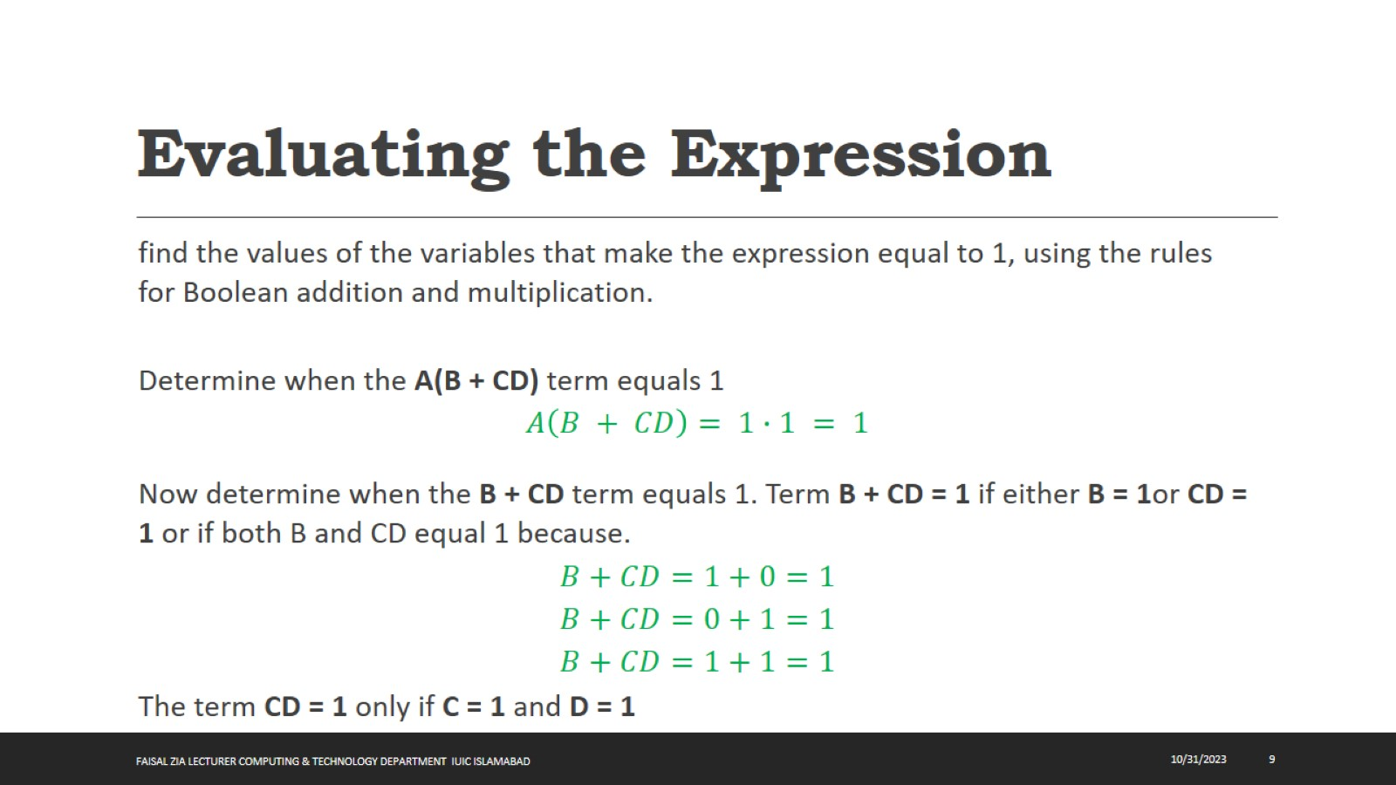
Evaluating the Expression

Slide 10
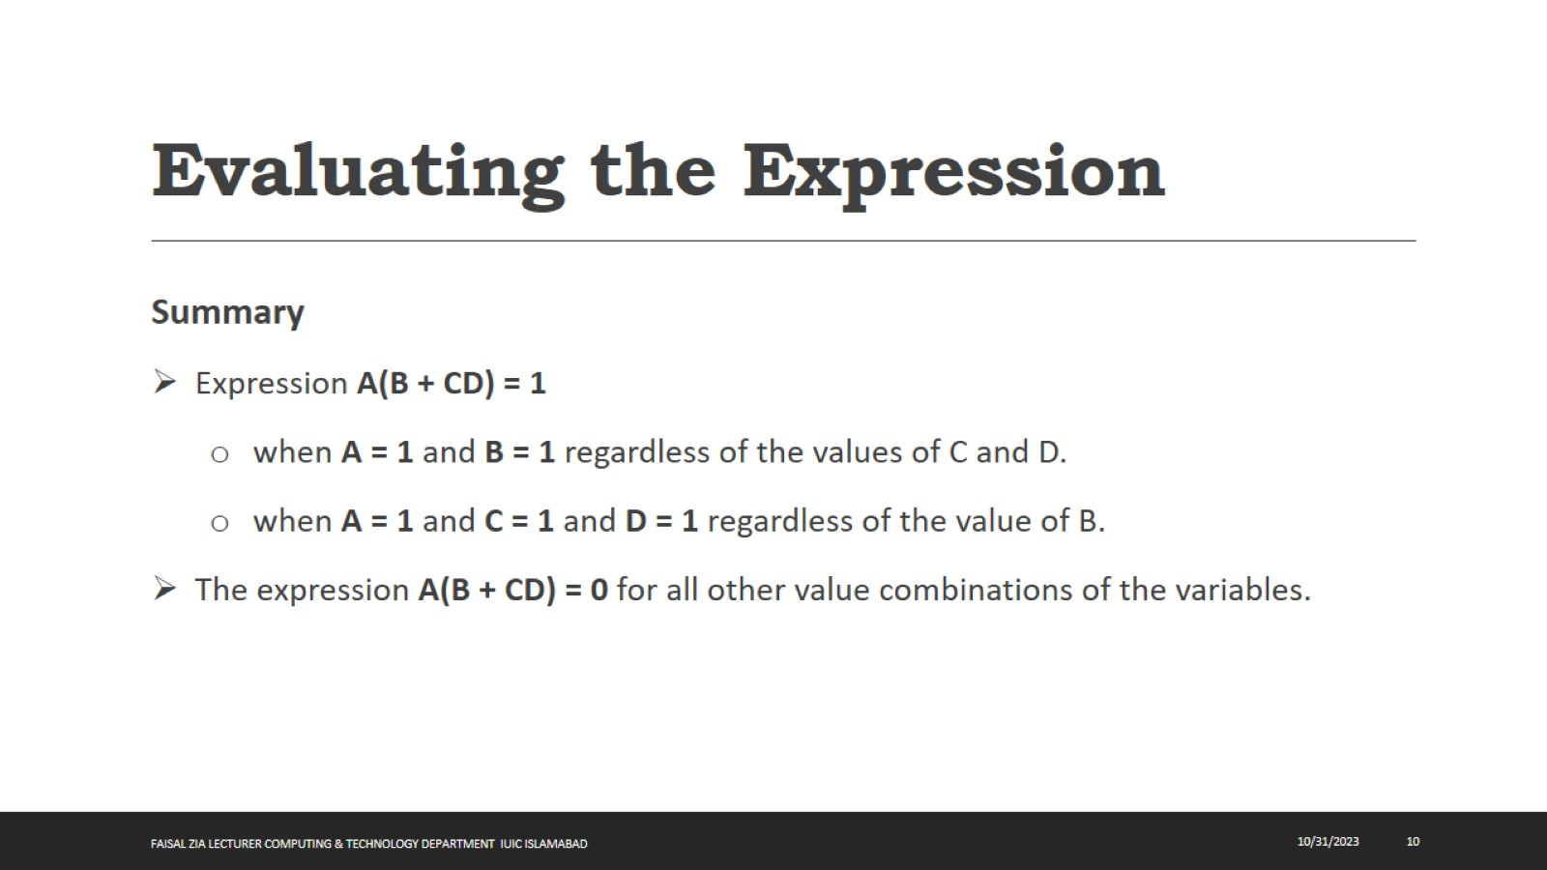
Evaluating the Expression

Slide 11
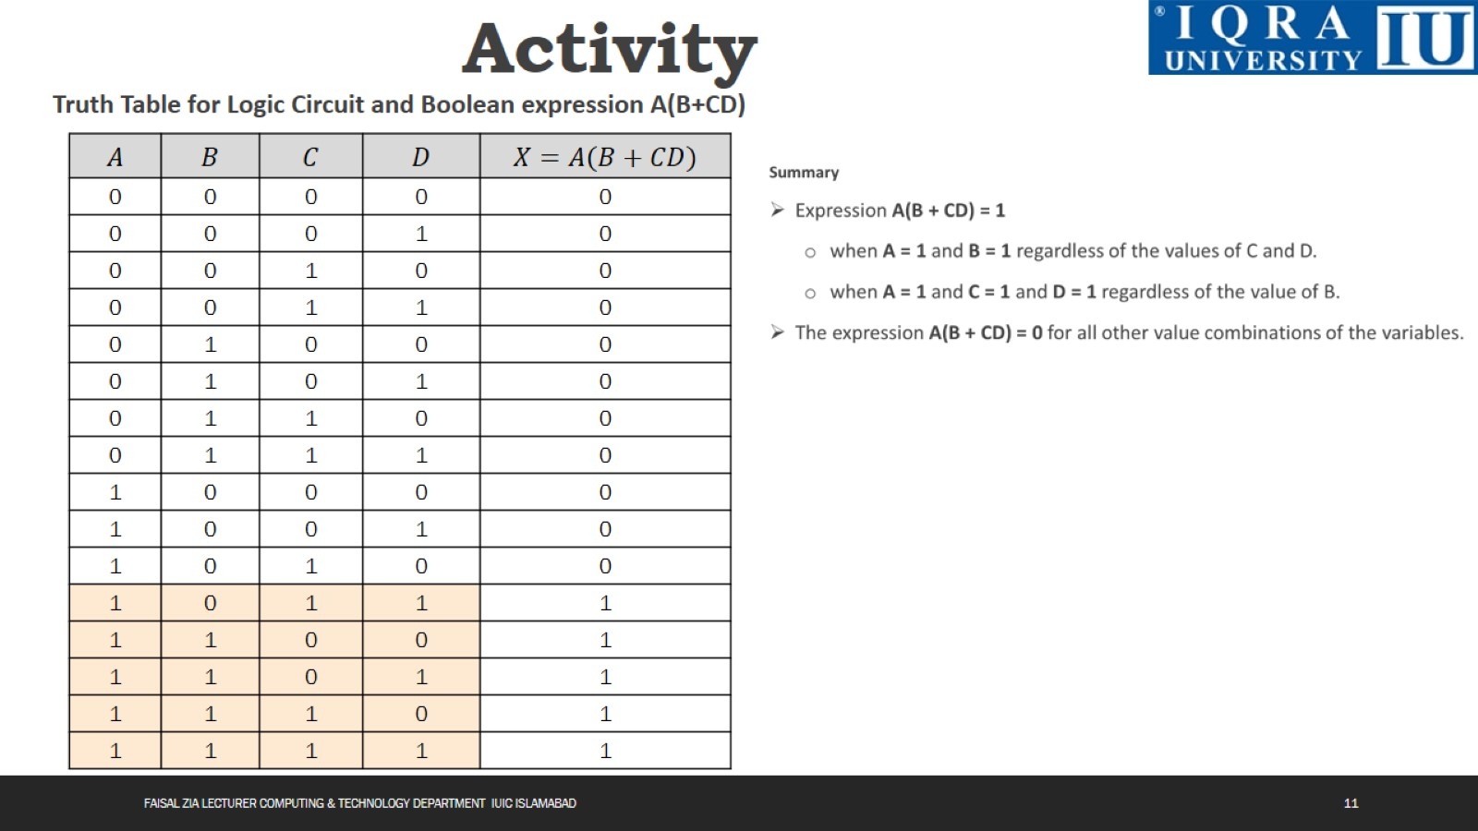
Activity

Slide 12
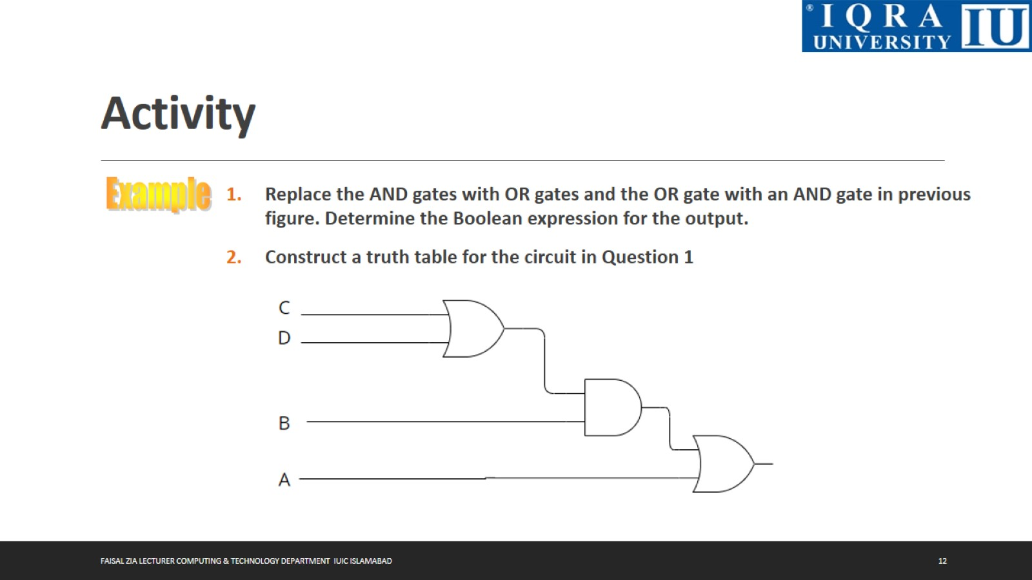
Activity

Slide 13
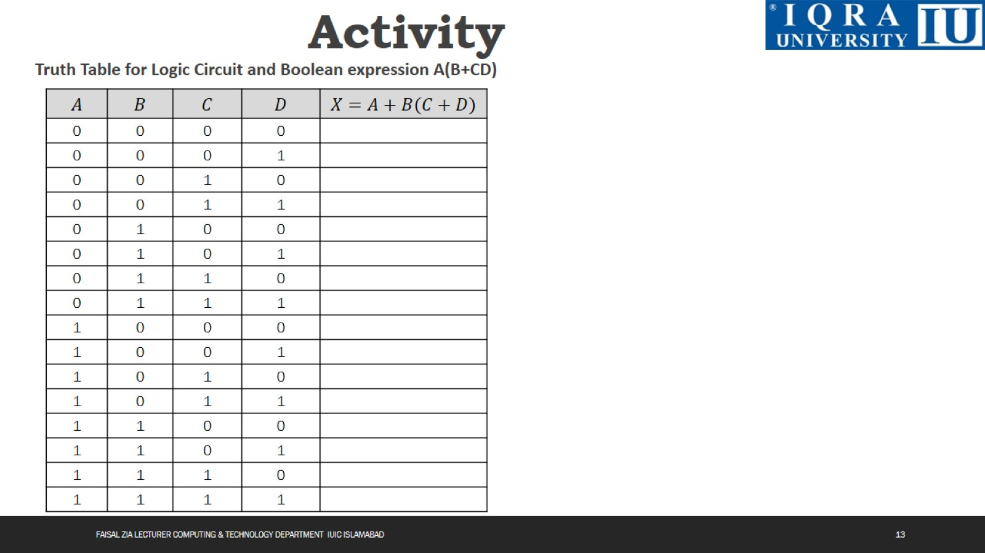
Activity

Slide 14
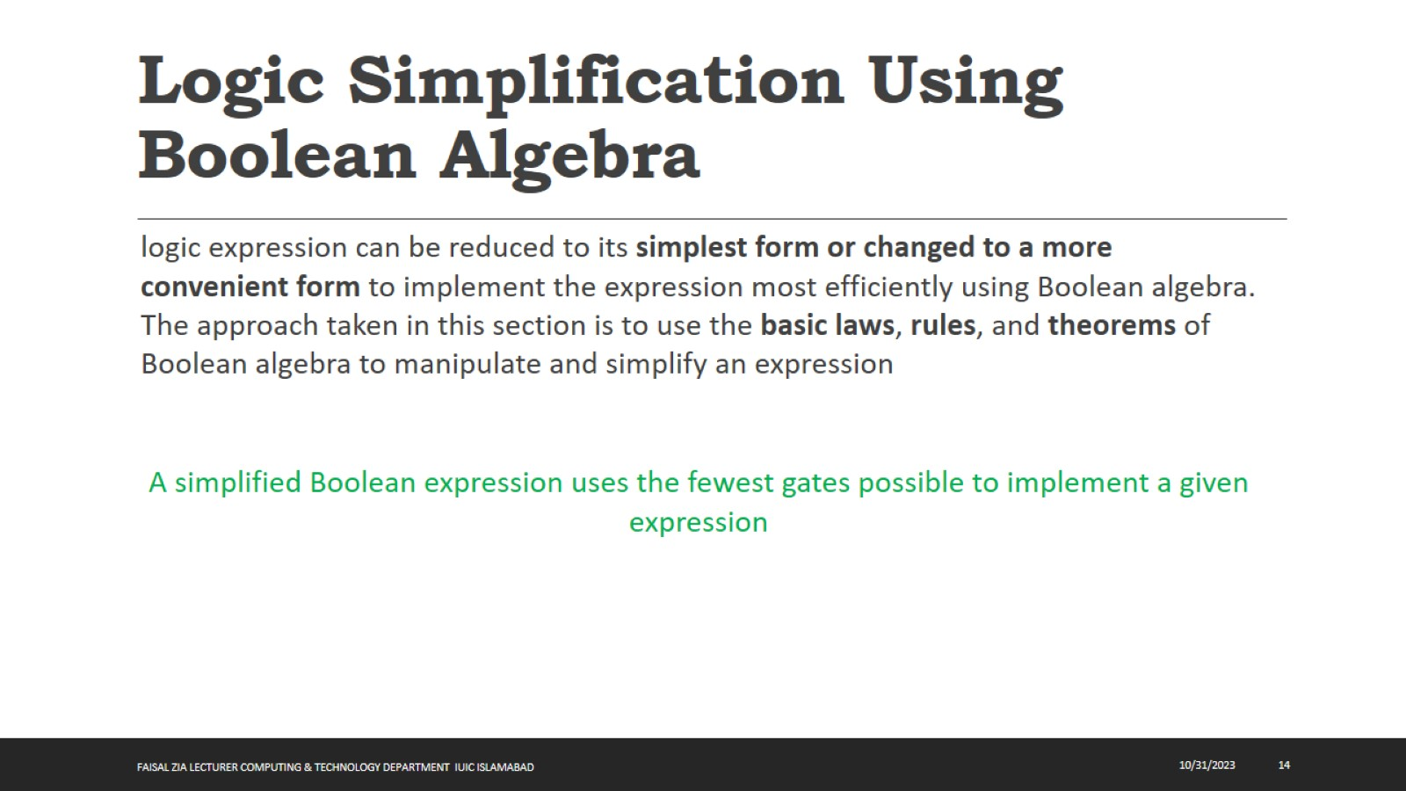
Logic Simplification Using Boolean Algebra

Slide 15
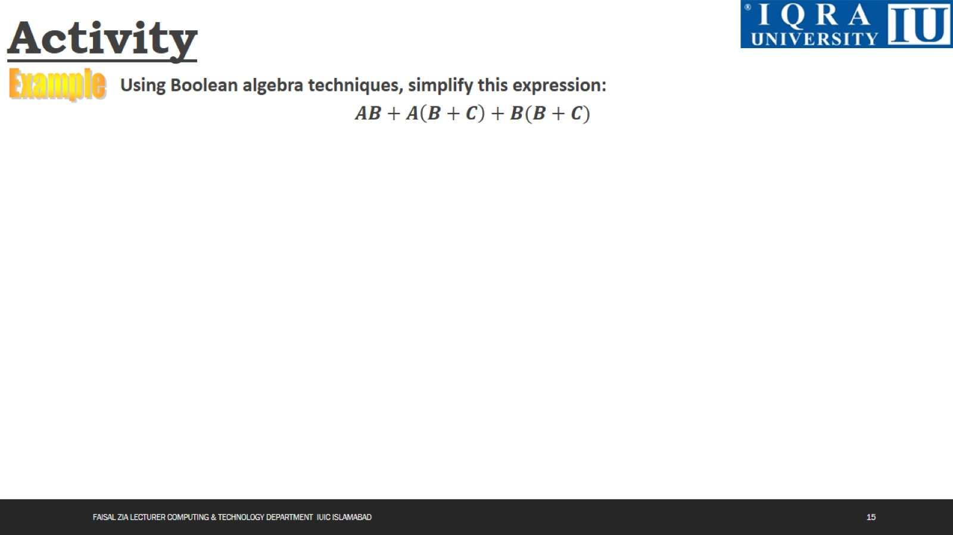
Activity

Slide 16
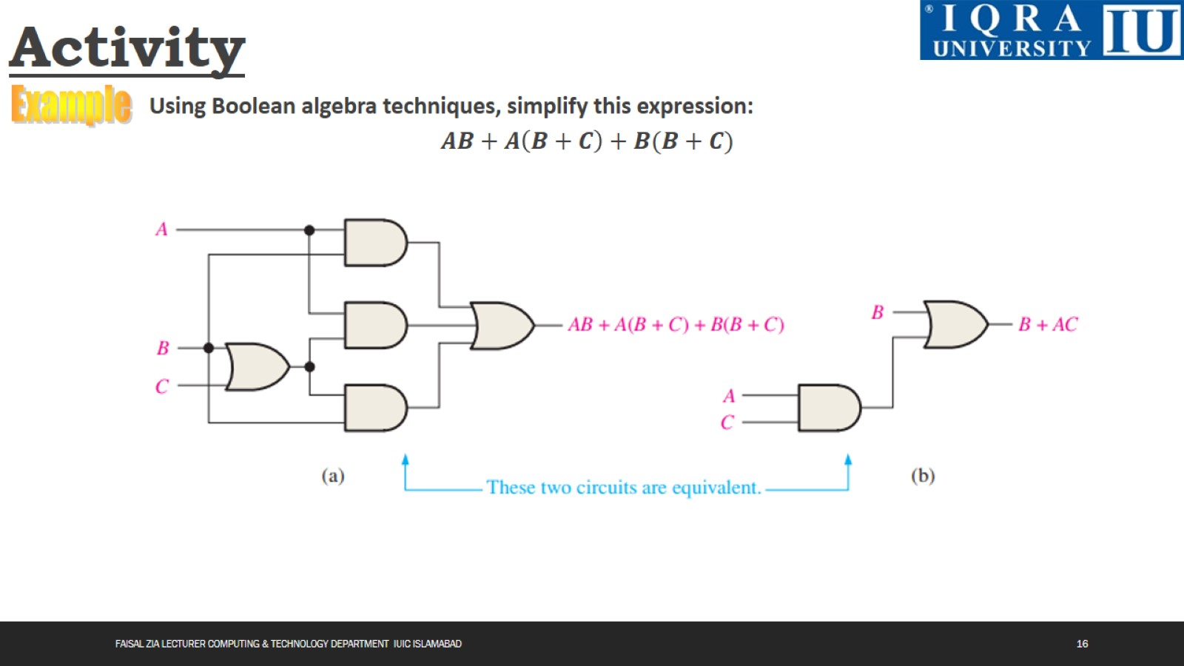

Slide 17
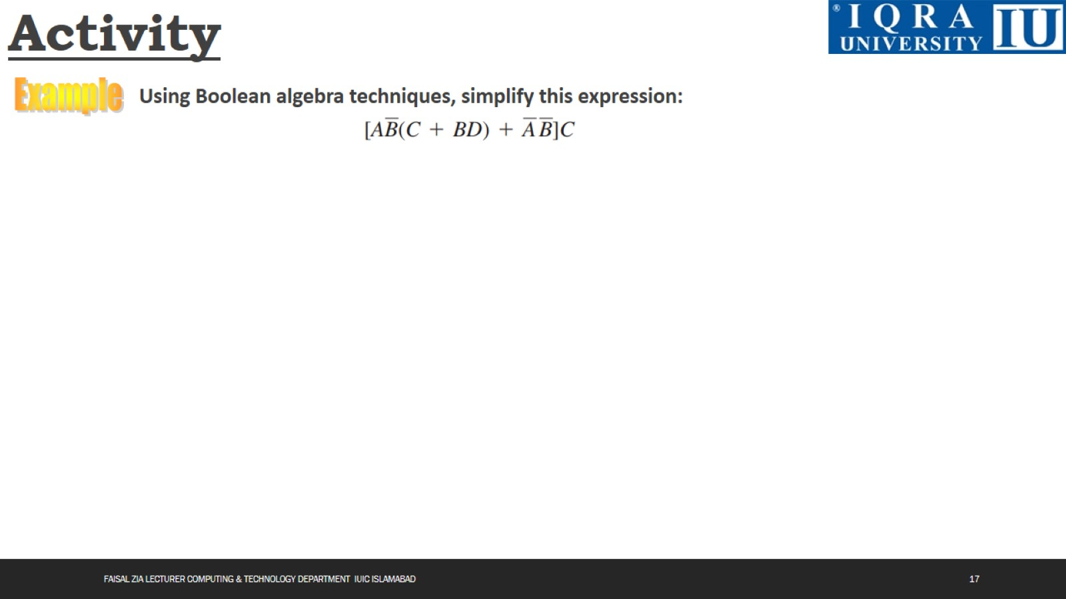
Activity

Slide 18

Activity

Slide 19

Activity

Slide 20
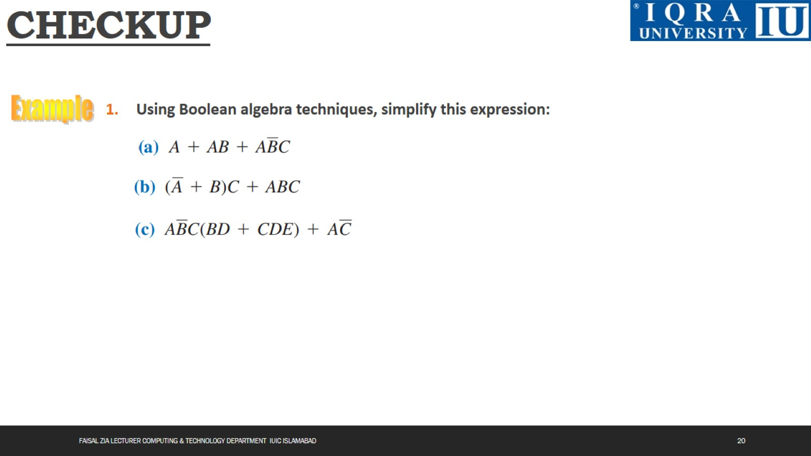
CHECKUP

Slide 21
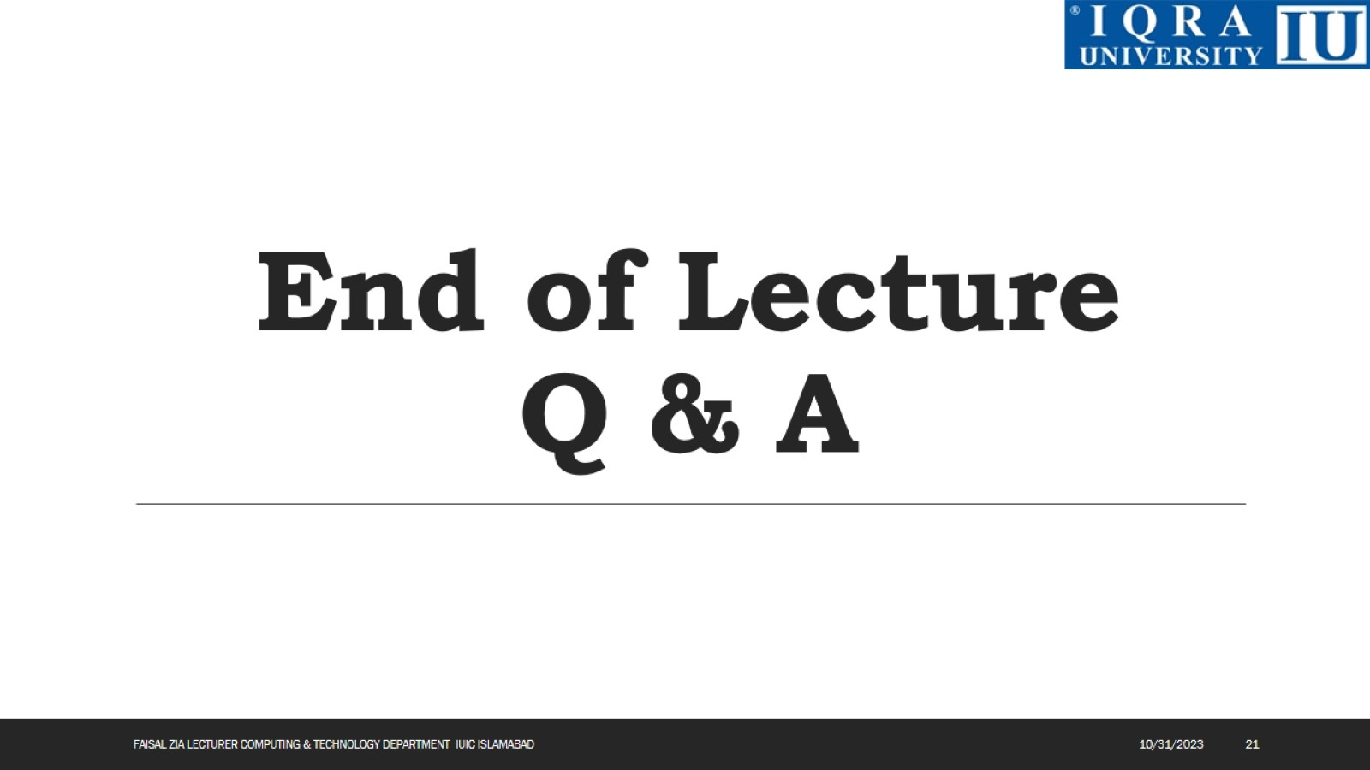
End of Lecture Q & A

